Slide 1
Chapter Five
Bootstrap

Slide 2
Introduction
Bootstrap’s primary objective is to create responsive, mobile-first websites.
Mobile-first design approach enables web designers to start product design for mobile devices first.
This can be done by sketching the website’s design for the smallest screen first and gradually working up to larger screen sizes.
But how are these style changes possible across all devices?
Through custom media query rules

Slide 3
Takeaway question
What was the initial purpose behind the development of Bootstrap?
Explain the concept mobile-first design?
What methods can we use to create responsive web pages?

Slide 4
Media queries
Media query is a CSS technique introduced in CSS3.
Media queries are a way for web developers to apply styles to a webpage based on characteristics of the device or browser that is being used to view it.
These characteristics can include screen width, height, and device orientation,
A media query consists of a condition and a set of styles that should be applied if that condition is true.
If the condition is met (for example, if the screen width is less than 600 pixels), the specified styles will be applied; otherwise, they will be ignored.

Slide 5
Media queries example
/* Styles for all screens */
body {
font-size: 16px;
}
/* Media query for screens with a width of 600 pixels or less */
@media (max-width: 600px)
{
body {
font-size: 14px;
}
}

Slide 6
Takeaway question
Write a simple media query that adjusts the font size to 18 pixels for screens with a width of 800 pixels or more. Assume the default font size is 16 pixels.
Write a media query that changes the body background color to green only if the screen width is between 400 and 600 pixels.

Slide 7
Solution
@media (min-width: 800px) {
body {
font-size: 18px;
}
}
2. @media (min-width: 400px) and (max-width: 600px) {
body {
background-color: green;
}
}

Slide 8
Why use bootstrap?
Bootstrap addresses several challenges that web developers commonly face
Responsive Design: Bootstrap provides a responsive grid system and a set of pre-built components that automatically adjust to different screen sizes.
Cross-Browser Compatibility: Bootstrap is designed and tested to work well across major browsers, helping developers avoid compatibility issues
Development Speed: Bootstrap includes a variety of ready-to-use components like navigation bars, buttons, forms, and more. These components can be easily integrated into a project

Slide 9
Bootstrap.css
In order to use Bootstrap, you need to integrate it into your development environment.
Step 1: Download Bootstrap
Visit the official Bootstrap website (https://getbootstrap.com/) and click on the "Download" button.
Unzip the downloaded folder to access the necessary CSS and JS files.
Step 2: Include Bootstrap Files in Your Project
In your HTML file, include the Bootstrap CSS file in the <head> section.
<link rel="stylesheet" href="path/to/bootstrap/css/bootstrap.min.css">
Notes:
Cross-Origin Resource Sharing (CORS) is an HTTP-header based mechanism that allows a server to indicate any origins (domain, scheme, or port) other than its own from which a browser should permit loading resources.

Slide 10
Bootstrap.css
You can also add it by linking to the Bootstrap CDN (Content Delivery Network)
<link rel="stylesheet“ href="https://maxcdn.bootstrapcdn.com/bootstrap/4.0.0/css/bootstrap.min.css">
Step 3: Start Using Bootstrap Classes
Once you've included the Bootstrap files, you can start using Bootstrap classes in your HTML.
Bootstrap.min.css contains prewritten style rules written in CSS
If we want to apply these styles, we assign one of the pre-written CSS classes to an HTML element. For example,
<img src=“apple1.jpg" class="rounded-circle" alt=“apple tree">
The .rounded-circle class shapes the image to a circle
Notes:
So to use Bootstrap, you need to know class names

Slide 11
Components commonly found in bootstrap
Containers: Containers in Bootstrap are used to wrap and contain the page's content. They provide a consistent margin and padding, helping with the layout and spacing of elements.
Grids: Bootstrap's grid system allows you to create a responsive layout by dividing the page into a grid of rows and columns.
Tables: Bootstrap provides styles for tables, making them look cleaner and more visually appealing. It includes features like striped rows, hover effects.

Slide 12
Cont’d
Jumbotron: A jumbotron is a large, prominent container for showcasing key content. It's often used for hero sections or prominently displaying important information.
Alerts: Bootstrap alerts are used to convey important information to the user. They can be styled to indicate success, warning, or error messages.
Cards: Cards are flexible content containers in Bootstrap. They can include images, text, buttons, and more, providing a versatile way to display information.

Slide 13
Containers
The Bootstrap framework uses a grid system to create content layouts.
When building a website using the Bootstrap framework, you need to specify a containing element for holding the bootstrap grid system.
The purpose of the grid system is to set the layout of the web pages and it comprises a series of rows with columns in each row.
Bootstrap requires a containing element to wrap site contents
They are the most basic layout tool available to the framework.
There are two types of containers

Slide 14
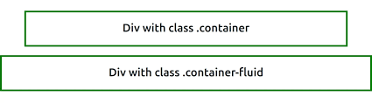
Containers cont’d
The first type of container, is referred to as the class container
The effect this class has is to center the container on standard desktop browser views with a width over 540px
The container class uses max-width breakpoints, a CSS rule that triggers upon a specific width.
The second type of container, is referred to as the fluid container
Rather than centering the container and adjusting the size at breakpoints, the container fluidly resizes to the width of the body element.

Slide 15
Class container
To assign a div, main or section element a container class, we use class=”container”
The container snaps to the following pixel widths.
540px, 720px, 960px, 1140px, 1320px
Between snaps it centers the container to the browser viewport.
<body>
<h1>Bootstrap Container</h1>
<p>The div below has container, and border classes attached.</p>
<div class="container">100% wide until small breakpoint
</div>
</body>
Notes:
"snapping" in the context of web development refers to the intentional and abrupt adjustment of layout or styling at specific breakpoints

Slide 16
Fluid container
The standard container snaps to pre-set pixel widths based on the size of the browser viewport.
The class container-fluid, however, adjusts to the browser viewport’s size without snapping.
Rather than centering the container and adjusting the size at breakpoints, the container fluidly resizes to the width of the body element.
The container is always 100% the width of the browser viewport.

Slide 17
Bootstrap Grid System
A grid is a structure comprising a series of lines (vertical or intersecting) that divide a page into columns
This structure helps designers to arrange content on a page
To align and layout content, the Bootstrap grid system uses a series of containers, rows, and columns.
To create a layout in bootstrap,
You first create a container (<div class="container">).
Next, a row (<div class="row">) inside container class
Then, a desired number of columns (<div class="col">) to add inside the <div> with row class

Slide 18
example
Example, two column split:
< div class=“fluid-container">
< div class="row border">
< div class="col border">
< h4 >This is the first column.</ h4 >
</ div >
< div class="col border">
< h4 >This is the second column</ h4 >
</ div >
</ div >
</ div >
What do you think the output will look like?
Notes:
A row will span the width of the container
Any column added after the 12th column will be shifted to a new line

Slide 19

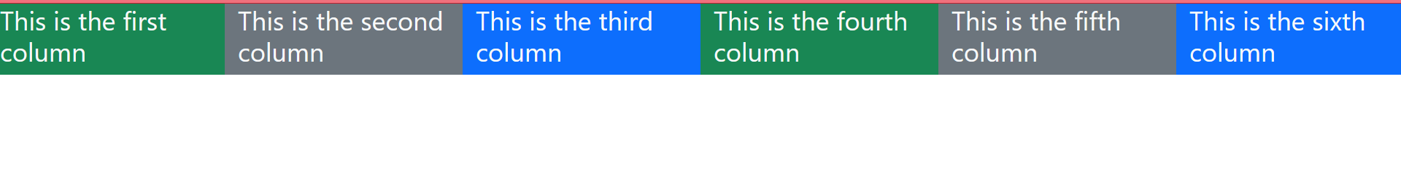
Grid cont’d
When we use the “col” class, Bootstrap will evenly distribute the space between the columns (if there are two columns in one row, the two will share the space equally);
Notes:
Col creates a cell in a row
This grid system supports a maximum of 12 columns

Slide 20
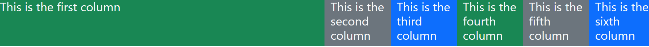
If we do not want to use all 12 column individually, we can group the columns together to create wider columns
col-* classes are used to define the width of individual columns within the grid system, and
they typically range from col-1 to col-12 representing different column widths.
<div class="row">
<div class="col-6">Column 1 (width 6)</div>
<div class="col-6">Column 2 (width 6)</div>
</div>
The sum of the column values within a row should not exceed 12 to maintain a proper Bootstrap grid system

Slide 21
Bootstrap Basic Table
A basic Bootstrap table has a light padding and only horizontal dividers.
The table class adds basic styling to a table
<table class="table">
<tr>
<th>Firstname</th>
<th>Email</th>
</tr>
<tr>
<td>John</td>
<td>john@example.com</td>
</tr>
</table>

Slide 22
More classes to style tables
Striped Rows: table-striped class adds zebra-stripes to a table
Bordered Table: table-bordered class adds borders on all sides of the table and cells
Hover Rows: table-hover class adds a hover effect (grey background color) on table rows
Condensed Table: table-condensed class makes a table more compact by cutting cell padding in half
Contextual classes to color table rows (<tr>) or table cells (<td>):
Active: applies the hover color to the table row or table cell
Success: indicates a successful or positive action
Info: indicates a neutral informative change or action
Warning: indicates a warning that might need attention
Danger: indicates a dangerous or potentially negative action

Slide 23
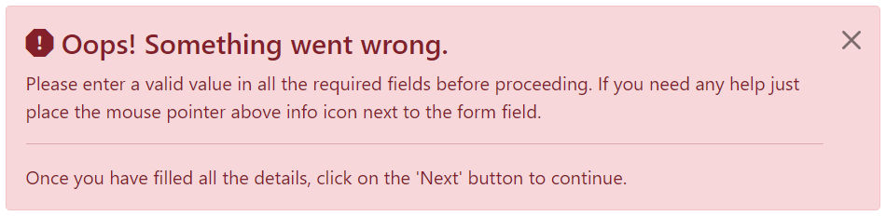
Bootstrap alerts
Alert boxes are used quite often to make an information that requires immediate attention of end users standout such as warning, error or confirmation messages
Example,

Slide 24
Bootstrap alerts
We use .alert class, followed by one of the contextual classes alert-success, .alert-info, .alert-warning, .alert-danger, .alert-primary, .alert-secondary, .alert-light or .alert-dark for proper styling
Example,
<div class="alert alert-primary" >
This is a primary alert—check it out!
</div>

Slide 25
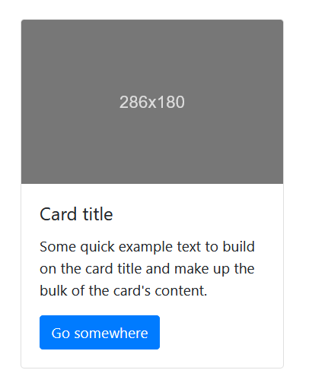
Bootstrap Cards
A card is a flexible and extensible content container that holds a few pieces of related information.
Each card is a single card class, which is then further divided into three parts. Card Header, Card Body, Card Footer

Slide 26
Basic Card
A basic card is created with the .card class, and content inside the card has a .card-body class
<div class="card"> <div class="card-body">Basic card</div> </div>

Slide 27
Header and Footer
The header of the card is made up of an image or a title.
If you use an image header you can move the heading into the card body, and write it as a single article of text
The card body, content inside the card has a .card-body class.
The card footer, can hold a summary of the card, details of the author, a call to action button, social media links
<div class="card">
<div class="card-header">header</div>
<div class="card-body">content</div>
<div class="card-footer">footer</div>
</div>

Slide 28
Cards are made up of the following class structure:
Card
card-header
card-img-top
card-body
card-title
card-text
card-footer
btn btn-primary

Slide 29
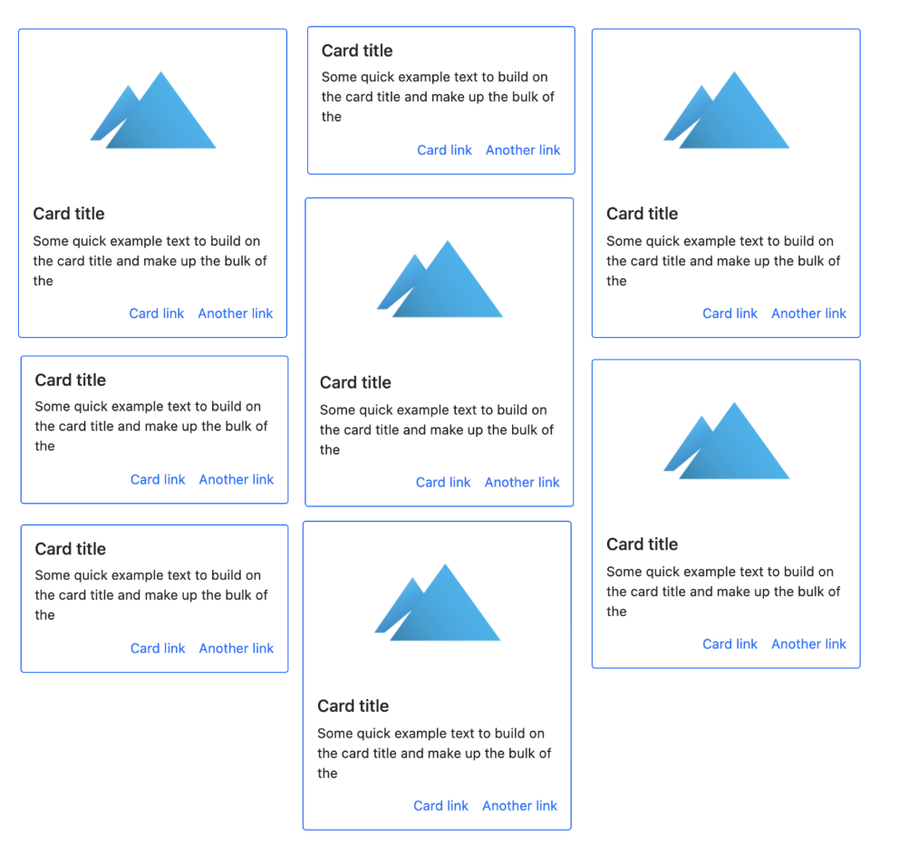
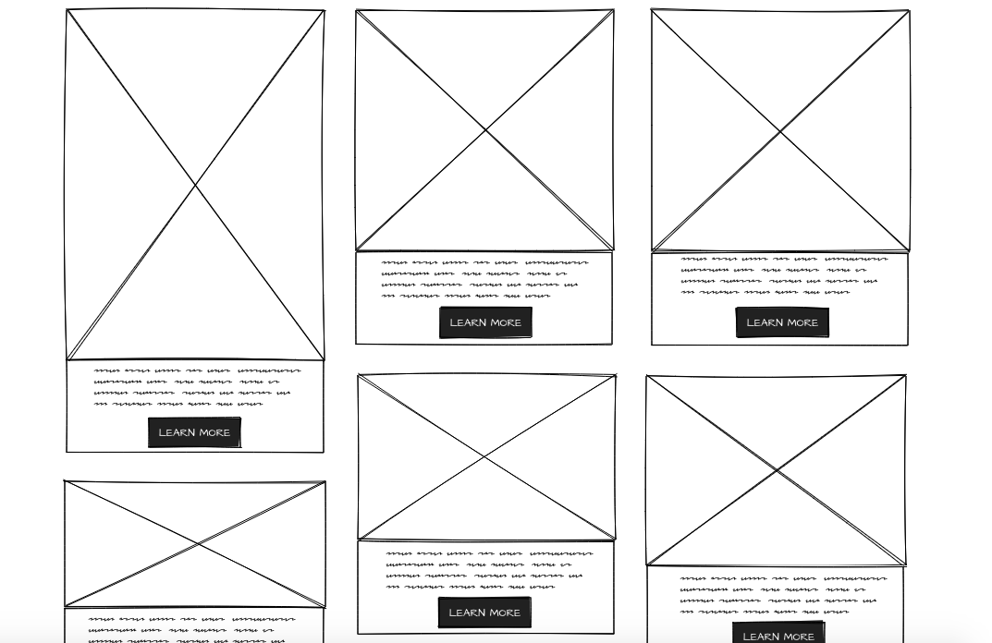
The .card-columns class creates a masonry-like grid of cards

Slide 30
Bootstrap Utility Classes Overview
Introduction, Examples, and Takeaway Questions

Slide 31
Introduction to Bootstrap Utility Classes
Bootstrap utility classes are predefined, single-purpose CSS classes that provide basic, often-repeated styling options.
They’re called "utility classes” because they’re designed to be small, reusable, and utilitarian—each class is intended to perform a specific "utility" function
Key Benefits:
- Quick application of styles
- Eliminates repetitive CSS
- Creates a consistent, readable structure
- Ideal for prototyping and rapid design changes

Slide 32
Introduction to Bootstrap Utility Classes
Single Responsibility: Utility classes typically apply one specific style property (like margin, padding, font-size, or background color)
High Reusability: Because each class is narrowly focused, utility classes are highly reusable across many components.
For example, .text-center can be applied to any element to adjust text alignment without needing custom CSS.
Ease of Use: By providing a library of utility classes, Bootstrap makes it easy to quickly apply common styles, speeding up development time and reducing the need to write additional CSS.
Notes:
bg-primary, p-3

Slide 33
1. Spacing Utilities
Control padding and margin with Bootstrap classes.
Syntax: {property}{sides}-{breakpoint}-{size}
Examples:
- m-3 (Margin on all sides)
- mt-5 (Top margin)
- px-4 (Padding left and right)

Slide 34
Takeaway question
How can you apply different margin values to the left and right sides of an element?
How would you use Bootstrap utility classes to create equal vertical spacing between multiple elements?
Which class removes all padding from an element?
Which class would you use to apply padding horizontally?

Slide 35
Predefined Breakpoints
Bootstrap defines standard breakpoints to cater to different device sizes. These breakpoints are associated with specific screen width ranges:
Extra Small (xs): <576px,
Small (sm): ≥576px,
Medium (md): ≥768px,
Large (lg): ≥992px,
Extra Large (xl): ≥1200px,
Extra Extra Large (xxl): ≥1400px
breakpoint prefixes are added to utility classes to apply different styles at different breakpoints.
For example:
col-md-6 applies a column width of 6 units (out of 12) when the screen size is at least 768px wide

Slide 36
Takeaway question
How can you apply a margin of 5 units to an element only on large screens and above?
Layout 3 cells in equal columns on a large display (eg. Desktop)
As you shrink the width, make the layout 2 columns on a medium width display (eg. Tablet)
Until finally, on a smaller resolution, the content stacks to a single column layout

Slide 37
2. Text Utilities
Control text alignment, decoration, transformation, and color.
Examples:
- text-center (Centered Text)
- text-uppercase (Uppercase Text)
- text-muted (Muted Text)
- text-danger (Red Text)
fw-bold (font weight to bold)
text-decoration-underline

Slide 38
Takeaway question
How would you make text appear lighter and less prominent using a Bootstrap utility class?
Which class would you use to make all letters uppercase?
How would you make text center-aligned on small screens but left-aligned on larger screens?
Notes:
<p class="text-center text-md-start">

Slide 39
3. Background Utilities
Set background colors based on the Bootstrap theme palette.
Examples:
- bg-primary (Primary Background)
- bg-success (Success Background)
- bg-light (Light Background)

Slide 40
4. Border Utilities
Control borders and rounded corners.
Examples:
- border (Basic Border)
- border-top (Top Border)
- rounded-circle (Circle Shape)
- border-danger (Red Border)

Slide 41
5. Display Utilities
Control the display property of elements for responsive layouts.
Examples:
- d-none d-md-block (Visible on md and larger screens)
- d-flex justify-content-center (Centered Flexbox Container)
- d-inline-block (Inline Block Element)

Slide 42
6. Flex Utilities
Use flex utilities to align, justify, and arrange flex items.
Examples:
- d-flex align-items-center (Centered on the cross axis)
- d-flex justify-content-between (Distributed items)
- d-flex justify-content-center (center items on the main)
- d-flex flex-column (Stacked items)
Notes:
d-flex flex-row (Stacked items)

Slide 43
Takeaway questions
What class would you use to enable a flex container in Bootstrap?
How would you make a flex container display its items in a row by default (horizontally)?
Which class would you use to align flex items to the center along the main axis?
How can you justify space between flex items so that they are evenly spaced across the container?
Notes:
3 justify-content-center 4 justify-content-between

Slide 44
7. Sizing Utilities
Set width, height, and maximum dimensions.
Examples:
- w-50 (50% width)
- h-25 (25% height)
- mw-100 (Max-width 100%)

Slide 45
9. Overflow Utilities
Control overflow behavior within elements.
Examples:
- overflow-hidden (Hidden overflow)
- overflow-auto (Scrollable overflow)

Slide 46
10. Visibility Utilities
Toggle visibility with visibility utility classes.
Examples:
- visible (Visible Element)
- invisible (Invisible Element that occupies space)

Slide 47
1. Background Utilities:
- What class would set a green background color?
2. Border Utilities:
- How would you add a circular border to an image?
3. Display Utilities:
- How would you make an element hidden on small screens and visible on medium?

Slide 48
Bootstrap cheat-sheet: https://hackerthemes.com/bootstrap-cheatsheet/

